Slide 1
EduBattle- The JEE Quest
By- Circuit Clan

Slide 2
OUR AIM:
Preparing for JEE Mains is often stressful and monotonous, primarily because traditional learning methods rely heavily on rote memorization and lack engagement.
When presented with a lot of study information, many students find it difficult to stay motivated and retain it.
Gamified learning increases motivation by 48% compared to traditional methods, and can increase learning retention by as much as 40%.
EduBattle is a educational game which provides a fun and interactive way to learn.
It reduces exam-related stress by making learning engaging.
Promotes healthy competition through leaderboards and rewards.
Combines education with entertainment to maintain interest over time.
Enhances critical thinking and problem-solving through strategic gameplay.

Slide 3
What Is edubattle?
The main aspect of EduBattle is to provide students with a creative and engaging portal by which they can learn.
Three characters, one for each of the subjects of chemistry, mathematics, and physics are up against the players.
Players must respond to topic-specific questions in order to win battles. The questions are also arranged in terms of levels- easy, medium and hard so that the user can slowly master the subject. Correct answers attack the opponent, while wrong answers lead to counterattacks.
Learning is made enjoyable and engaging by the game's thrilling final boss encounter, which incorporates questions from all three subjects.
This interactive game has a leader board that encourages healthy rivalry among users, encouraging them to monitor their progress over time and participate more fully in the learning process.

Slide 4
How does edubattle work?
EduBattle features a map with specifically created levels made on Unity. It is used for building the game and handling game logic, UI, and animations.
JSON is used to store and retrieve questions and answers for Physics, Chemistry, and Mathematics. It can randomize and display the questions on the basis of 3 levels-easy, medium and hard.
Programming Tools: Visual Studio Code/Visual Studio: As the IDE for writing and debugging Unity C# scripts.
Version Control: GitHub/Git: To collaborate with your team and manage code changes efficiently.

Slide 5
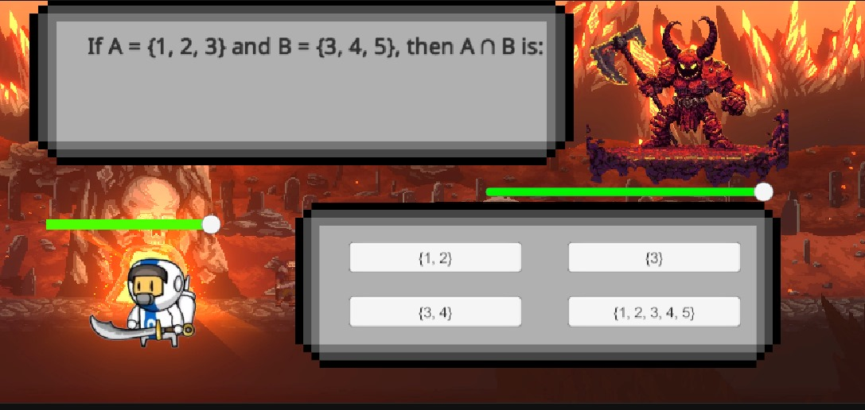
Pictures of the battle

